Slide 1
Apa yang dimaksud dengan konfigurasi transistor?
Konfigurasi transistor mengacu pada cara transistor dihubungkan dalam suatu rangkaian elektronik. Terdapat tiga konfigurasi transistor yang paling umum digunakan, yaitu:
Common Emitter (CE): Dalam konfigurasi ini, terminal emitter transistor dihubungkan ke ground (titik referensi tegangan), terminal kolektor dihubungkan ke sumber daya positif, dan sinyal input diberikan ke terminal basis. Konfigurasi ini memberikan penguatan arus dan tegangan, dan banyak digunakan dalam aplikasi penguat tegangan (amplifier) dan switch.
Common Collector (CC) atau Emitter Follower: Dalam konfigurasi ini, terminal kolektor transistor dihubungkan ke ground, terminal emitter dihubungkan ke sumber daya positif, dan sinyal output diambil dari terminal emitter. Konfigurasi ini memberikan penguatan tegangan dan impedansi input yang rendah, dan sering digunakan sebagai buffer antara sirkuit dengan impedansi output tinggi dan sirkuit dengan impedansi input rendah.
Common Base (CB): Dalam konfigurasi ini, terminal basis transistor dihubungkan ke ground, terminal kolektor dihubungkan ke sumber daya positif, dan sinyal input diberikan ke terminal emitter. Konfigurasi ini memberikan penguatan arus, dan sering digunakan dalam aplikasi penguat frekuensi tinggi.
Pemilihan konfigurasi transistor tergantung pada kebutuhan spesifik dari suatu rangkaian elektronik, termasuk penguatan, impedansi input/output, stabilitas, dan karakteristik frekuensi. Setiap konfigurasi memiliki kelebihan dan kelemahan tertentu yang harus dipertimbangkan dalam desain rangkaian.

Slide 2
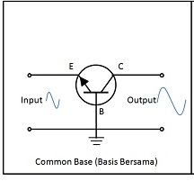
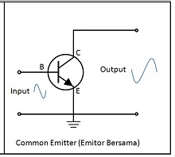
Konfigurasi Transistor BJT
Common-Base Configuration
Common-Collector Configuration
Common-Emitter Configuration
Common Collector
Common Base
Common Emitter
Common Base (CB), basis yang digroundkan
Common Collector (CC), kolektor yang digroundkan
Common Emitter (CE), emitor yang digroundkan

Slide 3
Common-Base Configuration

Slide 4
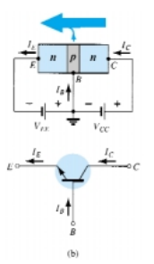
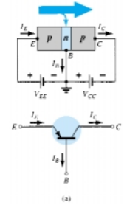
3.4 COMMON-BASE CONFIGURATION
The arrow in the graphic symbol defines the direction of emitter current (conventional flow) through the device
Figure 3.6 Notation and symbols used with the common-base
configuration: (a) pnp transistor; (b) npn transistor

Slide 5
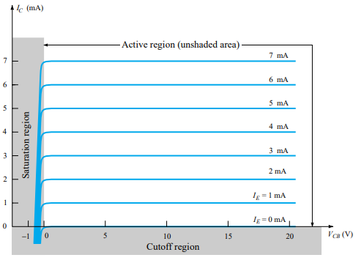
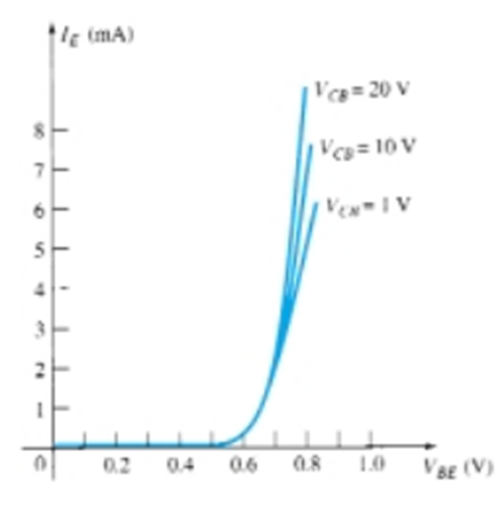
Karakteristik Input dan Output Transistor Common-Base
Figure 3.7 Input or driving
point characteristics for a
common-base silicon transistor
amplifier
Figure 3.8 Output or collector characteristics for a common-base transistor amplifier

Slide 6
Regions of Transistor: Active Region, Cut-off Region dan Saturation Region
To fully describe the behavior of a three-terminal device such as the commonbase amplifiers of Fig. 3.6 requires two sets of characteristics—one for the driving
point or input parameters and the other for the output side. The input set for the
common-base amplifier as shown in Fig. 3.7 will relate an input current (IE) to an input voltage (VBE) for various levels of output voltage (VCB).
The output set will relate an output current (IC) to an output voltage (VCB) for various levels of input current (IE) as shown in Fig. 3.8. The output or collector set of
characteristics has three basic regions of interest, as indicated in Fig. 3.8: the active, cutoff, and saturation regions. The active region is the region normally employed for linear (undistorted) amplifiers.
In the active region the collector-base junction is reverse-biased, while the
base-emitter junction is forward-biased
In the cutoff region the collector-base and base-emitter junctions of a transistor are both reverse-bias
In the saturation region the collector-base and base-emitter junctions are forward-biased.

Slide 7
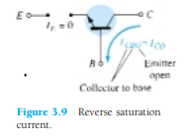


The curves clearly indicate that a first approximation to the relationship between IE and IC in the active region is given by
That is, once a transistor is in the “on” state, the base-to-emitter voltage will be assumed to be the following:

Slide 8





Slide 9
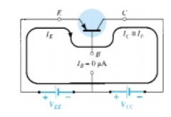

The proper biasing of the common-base configuration in the active region can be determined quickly using the approximation IC = IE and assume IB = 0 μΑ.

Slide 10
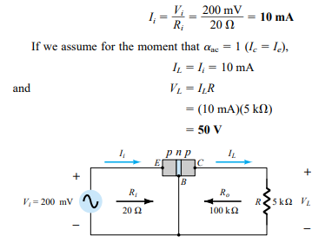
3.5 TRANSISTOR AMPLIFYING ACTION
Using a common value of 20 for the input resistance, we find that
Figure 3.12 Basic voltage amplification action of the common-base
configuration.

Slide 11
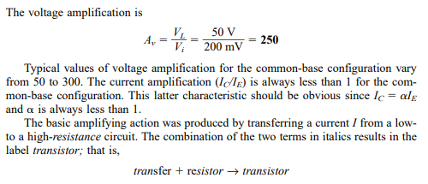

Slide 12
Common-Collector Configuration

Slide 13
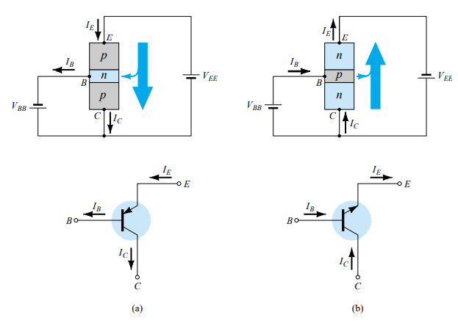
3.7 COMMON-COLLECTOR CONFIGURATION
GND
GND
Figure 3.20 Notation and symbols used with the common-collector configuration: (a) pnp transistor; (b) npn transistor

Slide 14
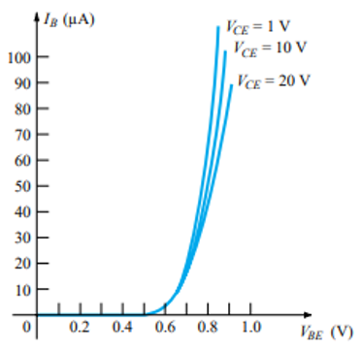
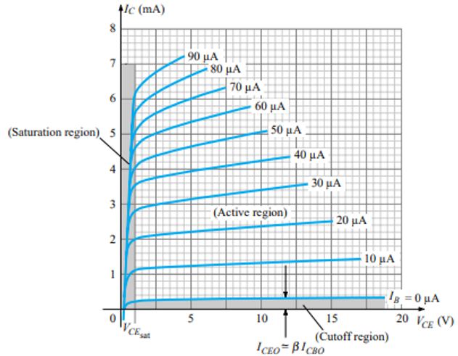
Common-Base Configuration
Common-Emitter Configuration

Slide 15
Cara Menggambarkan Konfigurasi Transistor
Gambarkan simbol transistor yang ingin digambar konfigurasinya.
Gambarkan arah arus yang mengalir pada kaki-kaki Basis, Emitor dan Kolektor.
Cantumkan notasi arus-arus tsb.
Berikan tanda Ground pada kaki yang akan dijadikan “Common” sesuai nama konfigurasinya (misal untuk Common-Base berarti kaki Basis yang dijadikan titik temu ground).
Berikan catu daya (baterai) antara kaki-kaki lainnya ke Ground (polaritas baterai sesuaikan dengan arah arus pada butir 2).
Cantumkan notasi tegangan-tegangan tsb.

Slide 16
Latihan
Gambarkan konfigurasi transistor berikut:
  Common-Base transistor PNP.
  Common-Base transistor NPN.
  Common-Emitor transistor PNP.
  Common-Emitor transistor NPN.
  Common-Kolektor transistor PNP.
  Common-Kolektor transistor NPN.
Tuliskan persamaan Ie dan Ic nya untuk masing-masing konfigurasi

Slide 17
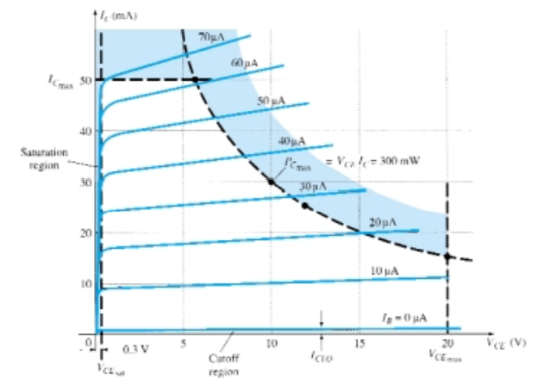
3.8 LIMITS OF OPERATION
Figure 3.22 Defining the linear
(undistorted) region of operation
for a transisto

Slide 18

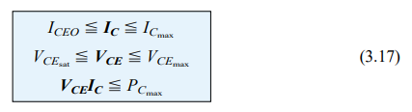


Slide 19
Common-Emitter Configuration

Slide 20
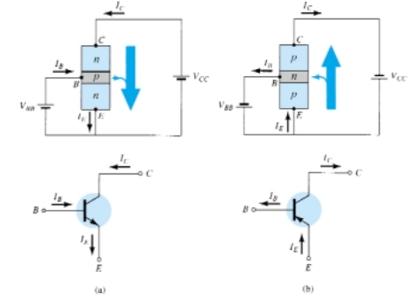
3.6 COMMON-EMITTER CONFIGURATION
GND
GND
Figure 3.13 Notation and symbols used with the common-emitter configuration: (a) npn transistor; (b) pnp transistor.

Slide 21
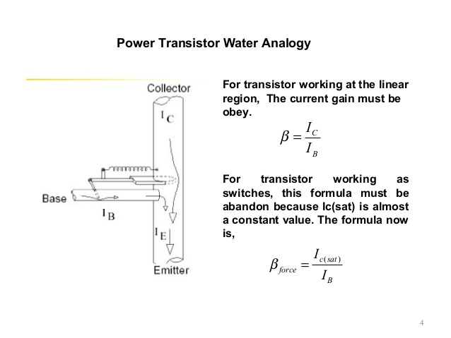

Slide 22
Karakteristik Input dan Output Transistor Common-Emitter
(b)
(a)
Figure 3.14 Characteristics of a silicon transistor in the common-emitter configuration: (a) collector characteristics; (b) base characteristics.

Slide 23
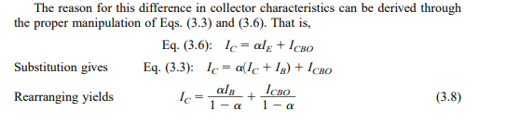
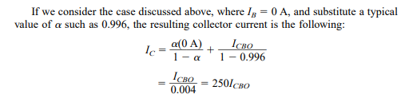
In the active region of a common-emitter amplifier the collector-base junction
is reverse-biased, while the base-emitter junction is forward-biased

Slide 24
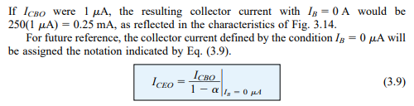
For linear (least distortion) amplification purposes, cutoff for the commonemitter configuration will be defined by IC = ICEO.

Slide 25



Bila Ic yang dihasilkan pada grafik tidak “datar” (tidak konstan) maka kita bisa gunakan persamaan ini.
Lihat cara penerapannya pada slide berikut.

Slide 26
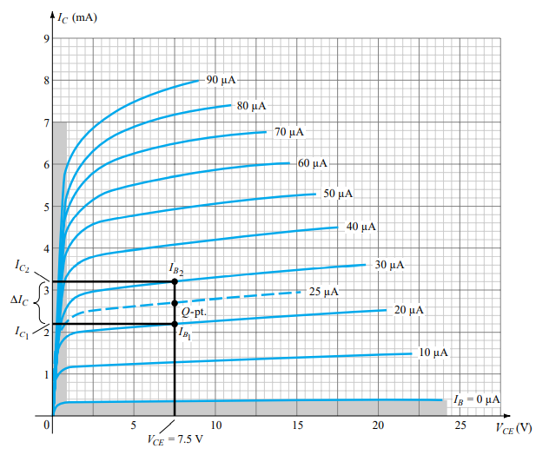
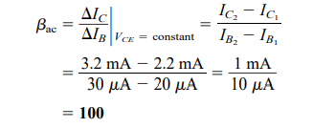

Disini terlihat Ic ada kecenderungan menaik sedikit, maka kita tentukan Delta Ic dengan 2 garis, lalu dapatkan delta Ib maka beta = delta Ic / delta Ib

Slide 27
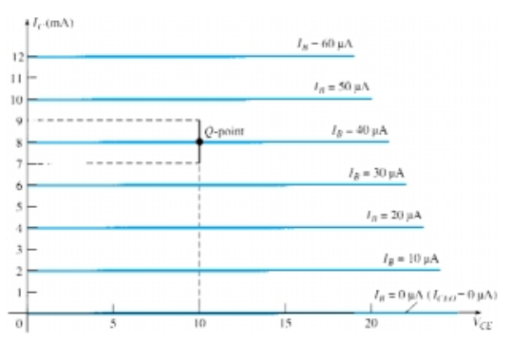
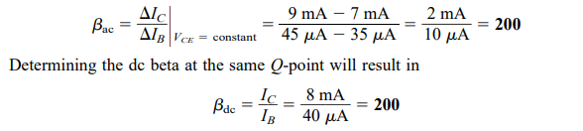

Slide 28
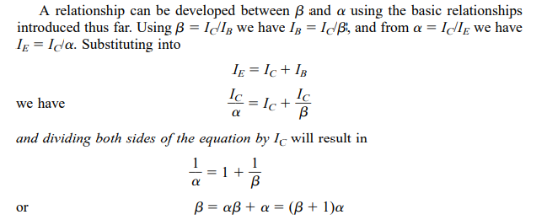
Hubungan antara Beta dan Alpha

Slide 29
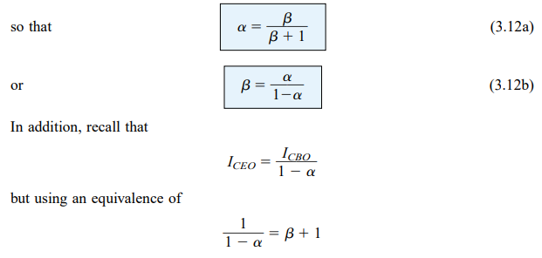

Slide 30
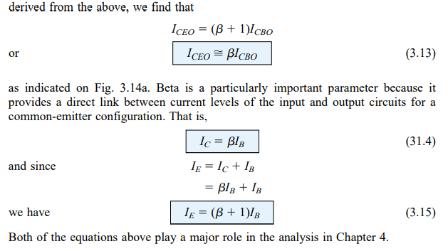

Slide 31
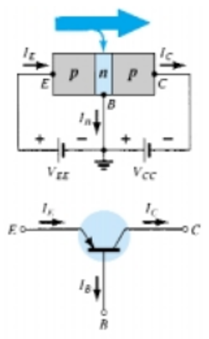
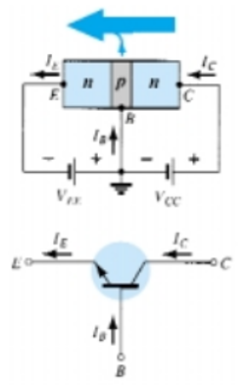
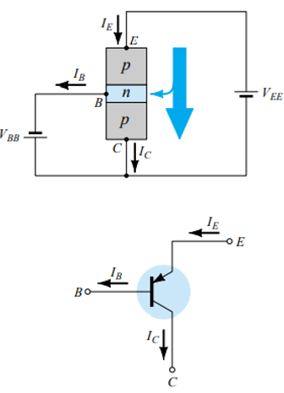
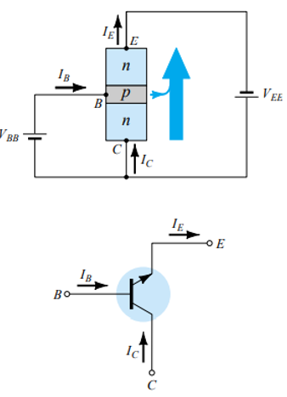
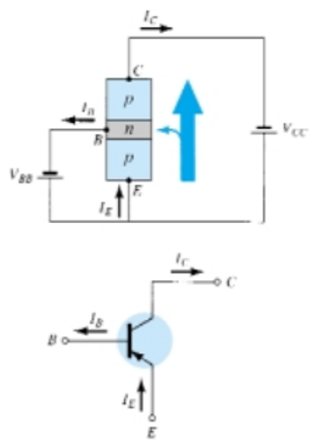
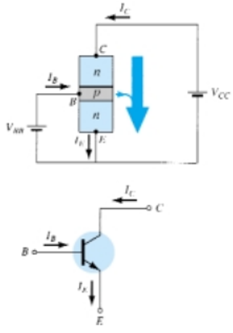
Resume Konfigurasi Transistor
Common-Base Configuration
Common-Collector Configuration
Common-Emitter Configuration
GND
GND
GND
GND
GND
GND
Ie = Ic + Ib => Ic
Veb
Vcb
Ie = Ic + Ib => Ic
Vbc
Vec
Ie = Ic + Ib => Ic
Vbe
Vce

